Slide 1

“Protect Me When I’m Vulnerable”
Plan for requirement study
Debasis Kar, Deepak Kumar, Abhilash Mishra

Slide 2
PROJECT OVERVIEW
We’re vulnerable in certain situations, e.g.
In case of a Medical Emergency
After consuming mind-altering substances such as alcohol
Emotional Breakdown etc.
Digital Tools (Mobile Apps) might be helpful to protect us in such situation.
We want to develop an app that supports an user in vulnerable situation, e.g.
Calls user’s mother if he/she doesn’t react
Blocks Contact
Put taxi companies on speed dial
Goal:
“To develop an app using human-centered design model
with required usability and utility.”

Slide 3
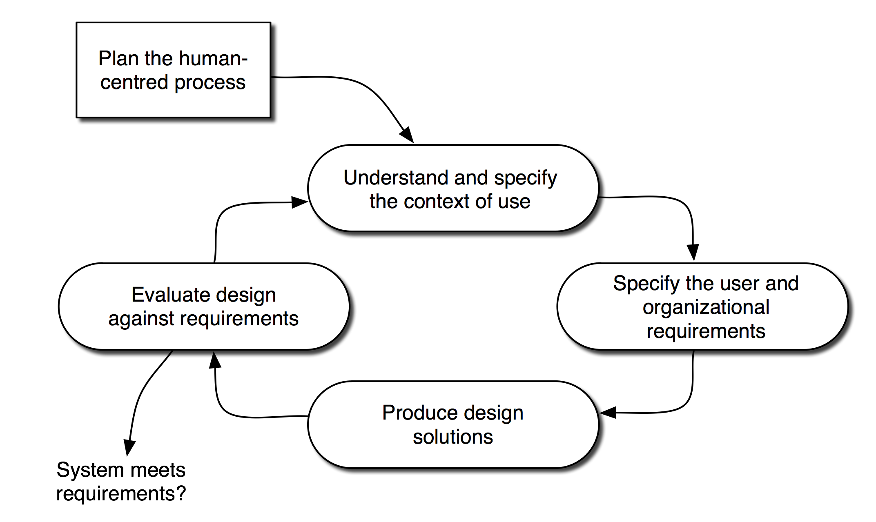
Human Centered Design Model
An approach to design that grounds the process in information about the people who will use the product.
ISO standard describes 6 key principles that will ensure a design is user centered:
Design is based upon an explicit understanding of users, tasks and environments.
Active involvement of Users.
The design is driven and refined by user-centered evaluation.
Iteration of design solutions.
The design addresses the whole user experience.
Multi-disciplinary design team.

Slide 4
Plans Prior Requirement Analysis
Domain Analysis:
It is the process by which a developer learns background information of a particular engineering process.
To perform domain analysis, we’ll gather information from whatever sources of information are available such as any existing software and its documentation:
DrunkBlocker Pro by Oscar Andersson (Google Play Store)
Drunk Dial NO! by Explore Fun Inc. (Apple iTunes)
The following benefits will make this work worthwhile:
Faster Development
Better System
Anticipation of Extensions

Slide 5
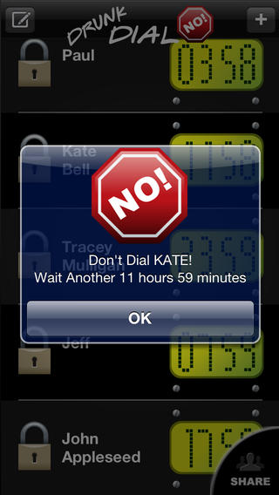
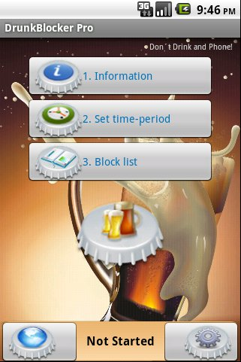
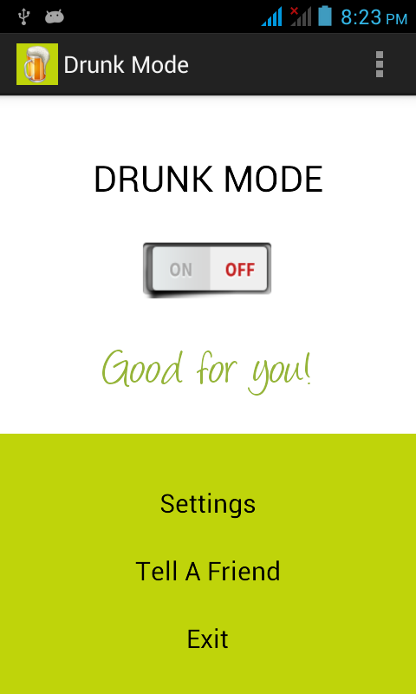
Existing Software Review
Courtesy: Drunk Dial No!
Courtesy: DrunkBlocker Pro
Courtesy: Drunk Mode

Slide 6
Requirements Gathering: Questionnaire
Requirements gathering is the practice of collecting the requirements of a system from users, customers and other stakeholders.
Requirements gathering is non-trivial because you can never be sure you get all requirements from the user and customer by just asking them what the system should do.
Requirements gathering practices include interviews, questionnaires, user observation, brainstorming, use cases and prototyping.
For a project of small scale,
We’ve planned to gather requirements and user’s preferences by
“Questionnaires using Likert’s Scale technique”
Our Questionnaire Is Available At: http://goo.gl/RPBzCo

Slide 7
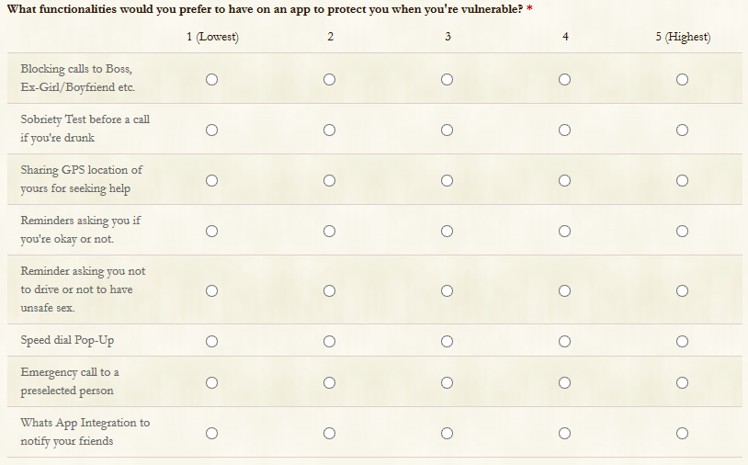
Questionnaire

Slide 8
Requirements
Requirement is a statement describing either
an aspect of what the proposed system must do OR
a constraint on the system’s development.
The set of requirements as a whole represents a negotiated agreement among all stakeholders.
Requirements can be divided into 4 major types:
Functional, Quality, Platform and Process.
Requirements documents (SRS) normally include at least the first two types.
Functional | Quality (Non-Functional) | Platform | Process
Utility | Usability | Operating System | Design Method-Model
Input/Output | Reliability | Technology to Use | Cost
Data to be Stored | GUI Learnability |  | Delivery Date
Timing & Synchronization | Resource Usage

Slide 9
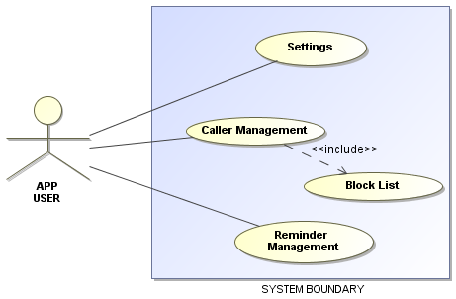
Use Case Analysis
It is a systematic approach to working out what users should be able to do with the software you are developing. It is one of the key activities.
1st Step: Determine the types of users or other systems that will use the facilities of this system. These are called actors.
2nd Step: An actor is a role that a user or some other system plays when interacting with your system; each actor will need to interact with the system in different ways.

Slide 10
Context Analysis
Context analysis is a method to analyse the platform environment in which the app will operate.
Platform: Android 4.0+
Target Audience: Medical Emergent People, People consuming heavy Alcohol
User Design Guideline:
Pictorial Buttons would be better than textual ones because they can catch attention easily.
Application should be intuitive, otherwise it would be irritating for some mundane tasks.

Slide 11
Final Plan Summary
Domain Analysis
Existing Software Review
Existing Document Review
Requirement Gathering
Questionnaire
Interview with target groups
Requirement Analysis
Use Case Analysis
Context Analysis
Results
Requirements & Context

Slide 12

THANK YOU!!!

